Slide 1
Advanced C++ Internals: Chapter 23: C++ Modules
ZACOCPPINT

Slide 2
Learning Journey:
IntroducingModules
Module Terminology What is a Module?
Why Modules?
General Module Name Syntax
Primary Module Interface
Interface and Implementation Module Units
Interface Module Units
Implementation Module Units
Public / Private
Import
Lab #39
Modules from a coding perspective
Summary
Appendices:
Useful links
Learning Outcomes:
Must be able to describe the importance of modules
Should be able to identify the key module components
Could be able to describe how modules are implemented
C++ Modules

Slide 3
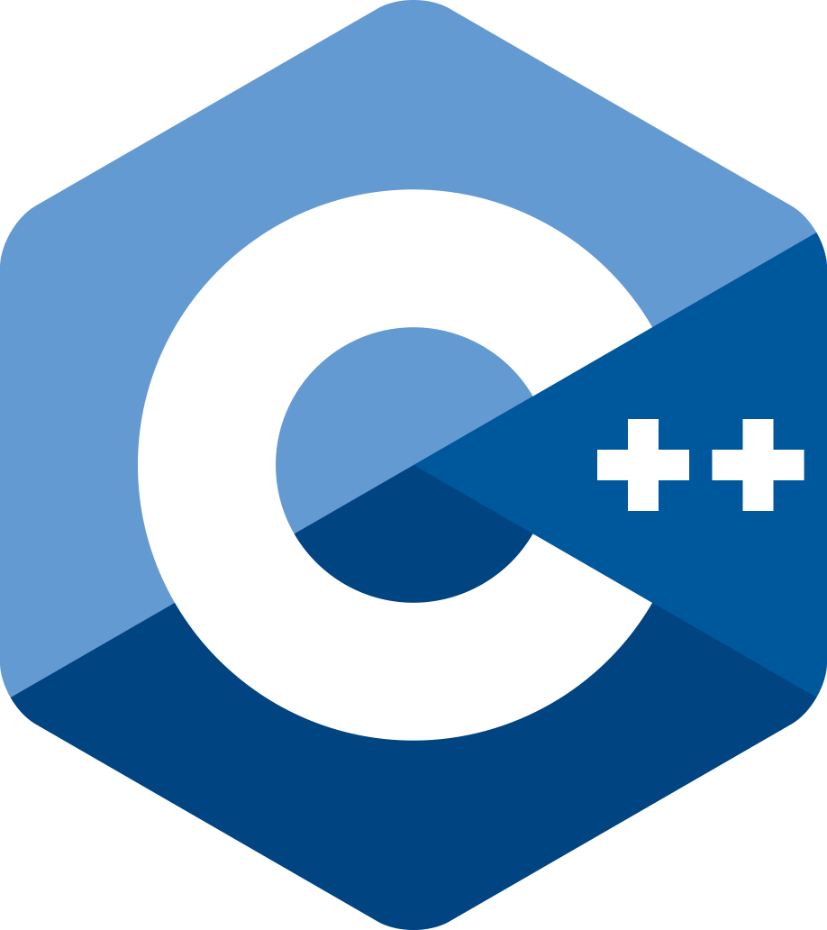
Modules were introduced in C++20
Modules replace both header files and source files
A Module exports the types required for compiling
A Module contains the definitions required for linking
Proper C++
No Pre-Processor
What is a Module?
// client.cppm
import yourLibrary;
import std;
int main() {
// use yourLibrary in the normal way
}

Slide 4
A Module is the complete representation of the facilities it offers
"Under the hood" a Module consists of one or more Module Units
A Module Unit is either a:
Module Interface Unit .ixx (≈.h)
Exporting names for client use
Module Implementation Unit .cppm (≈.cpp)
Providing non-exported definitions for internal module use
Module Terminology

Slide 5
A Module is a named entity that provides a public interface and supporting implementation code for clients
A client imports the module and can compile against its public interface.
Modules can be imported and used for compilation before their implementation code is complete.
The linker connects the implementation contained in the module units
A Module typically consists of several Module Units that are hidden from the client
What is a Module?

Slide 6

No new header files - every module unit is a source file
but can still use old header files
Module build order does not matter
Preprocessor macros are encapsulated in module units
Module Interfaces are compiled once
Binary file of its exported entities is created and saved
Module units specify which entities are visible
Client code imports and uses the exported part of a module
Changes to the non-exported parts of a module do not trigger recompilation for the client.
Why Modules?

Slide 7
[export] module <module.name>[:<partition.name>];
General Module Name Syntax
"module" and "export" cannot be part of a name.
dot seperator may be included in the name - but has no meaning
‘moduleName:partitionName’ names a partition but…
‘moduleName.partitionName’ does not name a partition.

Slide 8
Client code imports the primary module interface unit
It must be uniquely named
Its name is the module to which all its module-units belong
The facilities the module provides may be supplied by numerous module units which are hidden from the client.
Primary Module Interface
// anyUsefulName.ixx
// Primary Module Interface Unit
export module <module.name>;
// define stuff
// Client.cppm
import <module.name>;
// use stuff

Slide 9
Every Module Unit is either an Interface or an Implementation
Module Interface Unit - think “Header file”
Module Implementation Unit - think “.cpp file”
Interface and Implementation Module Units
export module <module.name>;
module <module.name>;

Slide 10
The Primary Module is an Interface Module Unit
Module name is prefixed with export keyword
export module MyModuleName;
Defines the public interface by exporting entities
Can include implementation code
Changes to non-exported parts do not trigger recompilation
Similar to old-style header files – except:
May contain non-inlined code
Changes to implementation do not trigger recompilation of the interface
Interface Module Units

Slide 11
Module name omits export keyword:
Implementation Modules are optional
Does not export anything to the client
Allows non-exporting code to be separated from other files
Like an old-style .cpp source file
module MyModuleName;
Implementation Module Units

Slide 12
Only export-ed names are public.
export may be applied to any entity at namespace scope:
variables
functions
struct / class
namespace
Everything within an exported scope is exported.
export must be applied to the first declaration of that name.
Cannot apply export inside any non-namespace scope
public / private

Slide 13
imports must come before any declaration:
Module Partition Units
Module Interface Unit
Module Implementation Unit
export module <modName>;
module <modName>;
Module Interface Partition Unit
Module Implementation Partition Unit
export module <modName>:<part-nameA>;
module <modName>:<part-nameA>;
Module Interface Partition Unit
Module Implementation Partition Unit
export module <modName>:<part-nameB>;
module <modName>:<part-nameB>;
Module Interface Partition Unit
export module <modName>:\<part-nameC>;
import std; // entire library
import <cassert>; // specific "header"
import

Slide 14
C++ Internals Lab #39
Modules (coding perspective)
Notes:
This lab focuses on using Modules from a coding perspective

Slide 15
Summary
Modules were introduced in C++20
Addresses historic issues around code dependencies, build times, and encapsulation of implementation details.
Modules achieve this by…
Removing reliance on header files and preprocessor instructions
Hiding implementation details more effectively
Requiring no guards to prevent multiple inclusions of header files
Provides a simplified build system
Results in an improved dependency management

Slide 16
Any questions?

Slide 17
Appendices
Notes:
Some additional information you may find useful…

Slide 18
Websites and online resources
C++ Standard Library (no date) cppreference.com. Available at: https://en.cppreference.com/w/cpp/standard_library (Accessed: 16 November 2023).
JTC1/SC22/WG21 - The C++ Standards Committee - ISOCPP (no date) . Available at: https://www.open-std.org/jtc1/sc22/wg21/ (Accessed: 16 November 2023).
Useful resources

Slide 19
Review of Chapter’s Learning Outcomes

Slide 20
Learning Outcomes:
By the completion of this chapter, you…
Must be able to describe the importance of modules
Should be able to identify the key module components
Could be able to describe how modules are implemented
Please review these learning outcomes at chapter's end.
Learning Outcomes

Slide 21
C++ Internals Case Study lab
Coding and Reverse Engineering
Notes:
This lab focuses on a lab using a more complex C++ binary.
What can you discover?
Work individually, in pairs or as a team ☺

Slide 22
Review of Learning Aim and Outcomes

Slide 23
Learning Aim:
To be able to successfully conduct reverse engineering of software written using modern C++ (including C++11 to C++ 2020 features).
Learning Outcomes:
By the completion of this module, you will be able to…
Identify C++ originated code (and concepts) within existing executable’s assembly language
Describe and interact with common low-level implemented mechanisms and architecture with respect to C++ concepts and structures
Interpret, debug and document C++ originated code at low level
Modify executable code to affect internal logic, change purpose or patch etc.
Please review these learning outcomes at programme's end.
Learning Outcomes

Slide 24
Thank you!
We’ve very much enjoyed working with you.
We hope you’ve enjoyed your learning programme, developed some new SRE skills with reference to Modern C++ concepts and syntax.

